Slide 1

AI and Covid - Presentation 3
Prof. Dr. Maria A. Wimmer, wimmer@uni-koblenz.de
Dr. Ulf Lotzmann, ulf@uni-koblenz.de
http://www.uni-koblenz.de/agvinf/
SoSe 2022

Slide 2
Team Members:
Irshad Hussain Mohammed
Manpreeth Vankadara
Nirav Satani
Pavan Kumar Tokachichu
Pavan Kumar Reddy Kancharla
Peram Navachandu Reddy
Ramesh Reddy Modulla
Rehan Ali Syed
Sudheer Kumar Gandham
Venkata Satya Aditya Jagarlapudi

Slide 3
Incidence Response Model for Global Pandemics

Slide 4
Agenda For The Meeting
Detailed Architecture.
Gantt Chart.
A Glance at the Data in hand.
Countries Identified.
Evidence of Correlation.

Slide 5
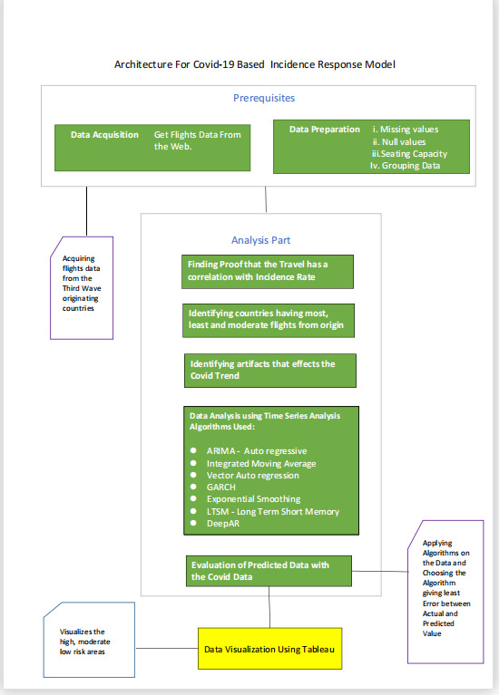

Slide 6
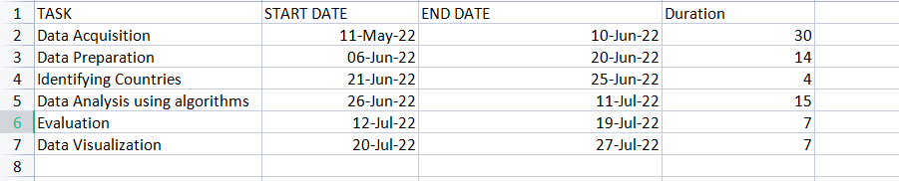
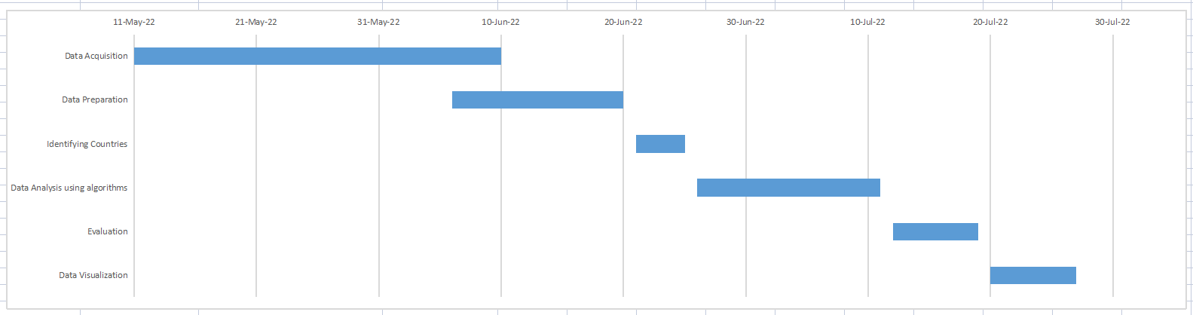
Gantt Chart

Slide 7
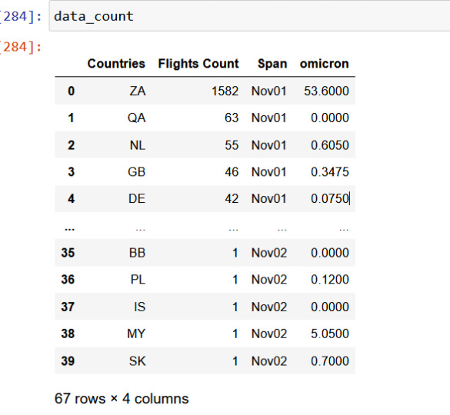
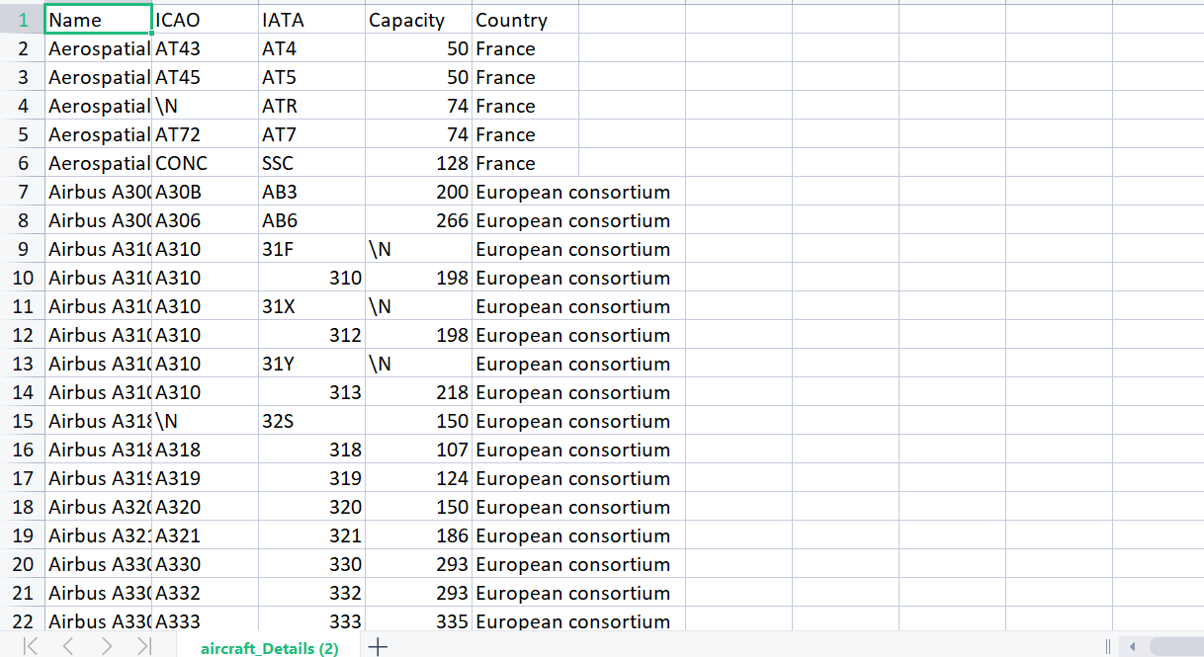
Data in Hand

Slide 8
High Outgoing Traffic to:
1. Qatar
2. Netherlands
3. Britain
4. Germany
5. France
Moderate Outgoing Traffic to:
1. Russia
2. Brazil
3. Spain
4. Sengal
5. Morocco
Low Outgoing Traffic to:
1. Slovakia
2. Bulgaria
3. Egypt
4. Equador
5. Iceland

Slide 9
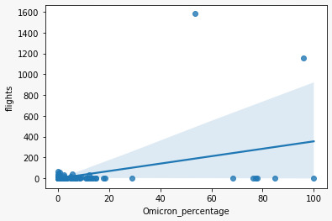
Evidence Of Correlation

Slide 10
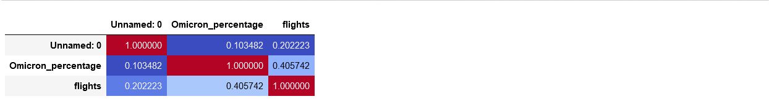
Evidence Of Correlation

Slide 11
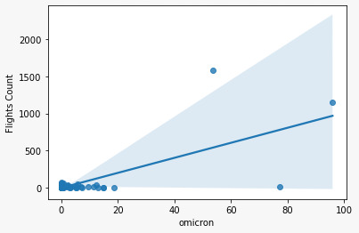
Evidence Of Correlation

Slide 12
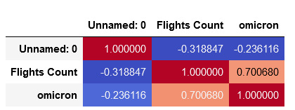
Evidence Of Correlation

Slide 13
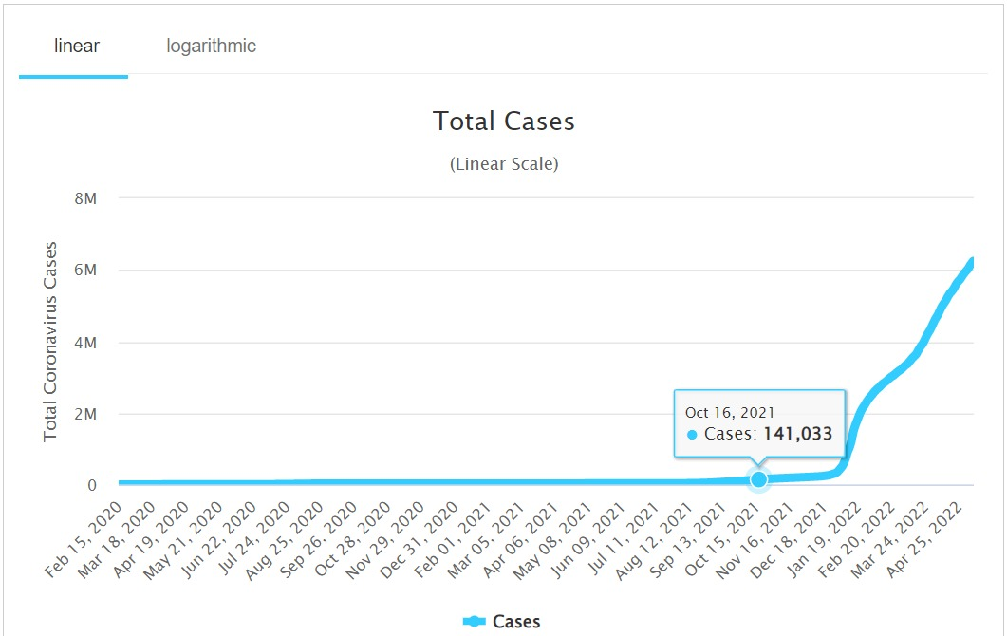
Travel Ban and Covid - Case Study of Australian Stratergy
https://www.worldometers.info/coronavirus/country/australia/?msclkid=7c658859cfe311ec8627cd1639da47f1

Slide 14
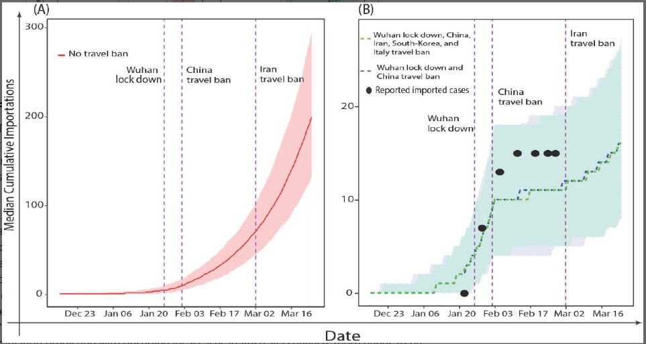
Travel Ban and Covid - Case Study of Australian Stratergy
https://onlinelibrary.wiley.com/doi/10.1111/1753-6405.13016

Slide 15
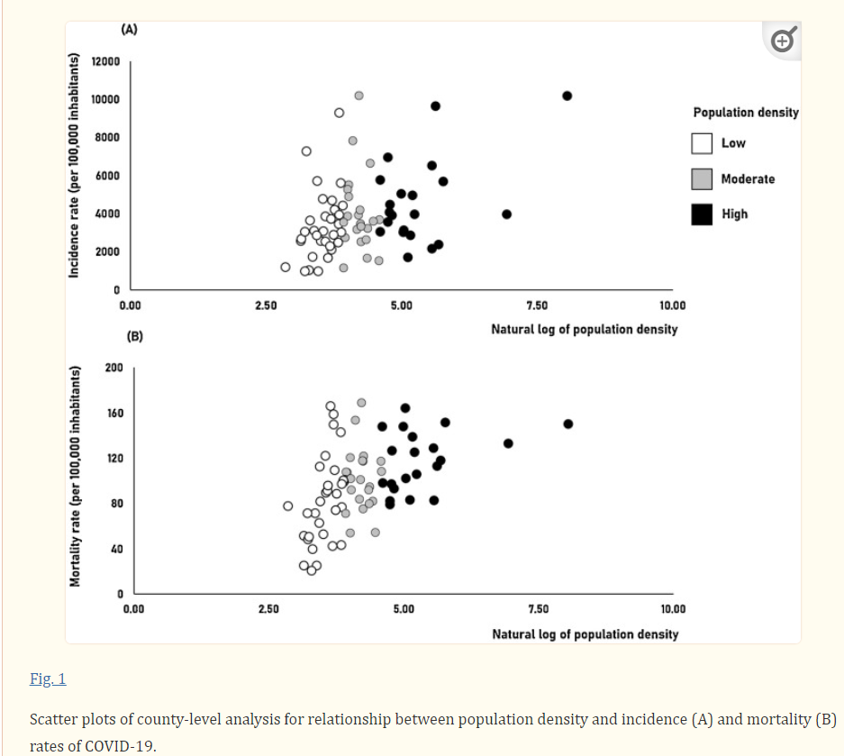
Population and Covid
https://www.ncbi.nlm.nih.gov/pmc/articles/PMC8253654/

Slide 16
Thank You

